Slide 1
New
2027
fonts

Slide 2
New!
SERIF FONTS
CHOOSE A SERIF FONT FOR:
Better Print Readability
Perceived Authority and Trust
Elegance and Heritage

Slide 3
SERIF FONT
New!
Body Copy
Headlines
Theme Phrase
A clean, contemporary, and geometric slab serif font

Slide 4
SERIF FONT
Body Copy
Headlines
Theme Phrase

Slide 5
SERIF FONT
Body Copy
Headlines
Theme Phrase

Slide 6
SERIF FONT
Body Copy
Headlines
Theme Phrase

Slide 7
SERIF FONT
Body Copy
Headlines
Theme Phrase

Slide 8
SERIF FONT
Headlines
Theme Phrase
Inline version is for larger uses only

Slide 9
SERIF FONT
Body Copy
Headlines
Theme Phrase

Slide 10
SERIF FONT
Body Copy
Headlines
Theme Phrase

Slide 11
SERIF FONT
New!
Body Copy
Headlines
Theme Phrase
Sophisticated and playful with a hint of Italian influence

Slide 12
SERIF FONT
Body Copy
Headlines
Theme Phrase

Slide 13
SERIF FONT
Body Copy
Headlines
Theme Phrase

Slide 14
SERIF FONT
Body Copy
Headlines
Theme Phrase

Slide 15
SERIF FONT
Body Copy
Headlines
Theme Phrase

Slide 16
SERIF FONT
Body Copy
Headlines
Theme Phrase

Slide 17
SERIF FONT
Body Copy
Headlines
Theme Phrase

Slide 18
SERIF FONT
New!
Body Copy
Headlines
Theme Phrase
A retro, soft serif font with a modern appeal

Slide 19
SERIF FONT
Body Copy
Headlines
Theme Phrase

Slide 20
SERIF FONT
Body Copy
Headlines
Theme Phrase

Slide 21
SERIF FONT
Body Copy
Headlines
Theme Phrase

Slide 22
SERIF FONT
Body Copy
Headlines
Theme Phrase

Slide 23
SERIF FONT
Body Copy
Headlines
Theme Phrase

Slide 24
SERIF FONT
Body Copy
Headlines
Theme Phrase

Slide 25
New!
SANS-SERIF FONTS
CHOOSE A SANS-SERIF FONT FOR:
Readability in Small Scale
Modern Brand Image
Approachable Tone

Slide 26
SANS-SERIF FONT
New!
Headlines
Theme Phrase
A bold, nostalgic sans inspired by magazine ads of the 80s and 90s

Slide 27

SANS-SERIF FONT
Headlines
Theme Phrase

Slide 28
SANS-SERIF FONT
Headlines
Theme Phrase

Slide 29
SANS-SERIF FONT
Headlines
Theme Phrase
Due to the thickness of Nineties Headliner, it is not well-suited for body copy.
Consider mixing with a classic serif like Baskerville.

Slide 30
New!
CHOOSE A SCRIPT FONT FOR:
Elegance, Personality, and a Human Touch
Soft or Creative Brand Image
Convey Celebration

Slide 31
SCRIPT FONT
New!
Headlines
Theme Phrase
Accents
A clean, elegant hand-drawn script font containing upper & lowercase characters

Slide 32
SCRIPT FONT
Headlines
Theme Phrase
Accents

Slide 33
SCRIPT FONT
Headlines
Theme Phrase
Accents

Slide 34
SCRIPT FONT
Headlines
Theme Phrase
Accents
Avoid using ALL CAPS
La Luxes Script makes a great accent and pairs well with an understated serif or sans-serif to maintain balance

Slide 35
SCRIPT FONT
New!
Headlines
Theme Phrase
Accents
A luxury, cursive script font inspired by traditional calligraphy

Slide 36
SCRIPT FONT
Headlines
Theme Phrase
Accents

Slide 37
SCRIPT FONT
Headlines
Theme Phrase
Accents
Avoid using ALL CAPS
New Icon Script makes a great accent and pairs well with an understated serif or sans-serif to maintain balance

Slide 38
SCRIPT FONT
New!
Headlines
Theme Phrase
Accents
Pull Quotes
A hyper-realistic handwritten font duo built from real handwritten words

Slide 39
SCRIPT FONT
Headlines
Theme Phrase
Accents
Pull Quotes

Slide 40
SCRIPT FONT
Headlines
Theme Phrase
Accents
Pull Quotes

Slide 41
SCRIPT FONT
Headlines
Theme Phrase
Accents
Pull Quotes

Slide 42
SCRIPT FONT
Headlines
Theme Phrase
Accents
Pull Quotes
September Spirit makes a great accent and pairs well with a serif or sans-serif to maintain balance

Slide 43
New!
CHOOSE A DISPLAY FONT TO:
Bring Big Personality
Act as a Visual Anchor
Convey Emotions or Eras at a Glance

Slide 44
DISPLAY FONT
New!
Headlines
Theme Phrase
This hand-brushed set is a combo of informal scripts and handwritten fonts

Slide 45
DISPLAY FONT
Headlines
Theme Phrase

Slide 46
DISPLAY FONT
Headlines
Theme Phrase

Slide 47
DISPLAY FONT
Headlines
Theme Phrase

Slide 48
DISPLAY FONT
Headlines
Theme Phrase

Slide 49
DISPLAY FONT
Headlines
Theme Phrase
Because display fonts can not be used for body copy, they need to be paired with an understated serif or sans-serif font

Slide 50
DISPLAY FONT
New!
Headlines
Theme Phrase
A modern and stylish serif font

Slide 51
DISPLAY FONT
Headlines
Theme Phrase

Slide 52
DISPLAY FONT
Headlines
Theme Phrase

Slide 53
DISPLAY FONT
Headlines
Theme Phrase
La Luxes Script and La Luxes Serif fonts can be used together. Add a clean sans-serif for body copy.

Slide 54
DISPLAY FONT
New!
Headlines
Theme Phrase
This font is a sophisticated, unique, playful and versatile serif family

Slide 55
DISPLAY FONT
Headlines
Theme Phrase

Slide 56
DISPLAY FONT
Headlines
Theme Phrase

Slide 57
DISPLAY FONT
Headlines
Theme Phrase

Slide 58
DISPLAY FONT
Headlines
Theme Phrase

Slide 59

DISPLAY FONT
Headlines
Theme Phrase
Because display fonts can not be used for body copy, they need to be paired with an understated serif or sans-serif font

Slide 60
DISPLAY FONT
New!
Headlines
Theme Phrase
A display sans font family inspired by late 19th century’s gothic typefaces

Slide 61


DISPLAY FONT
Headlines
Theme Phrase

Slide 62
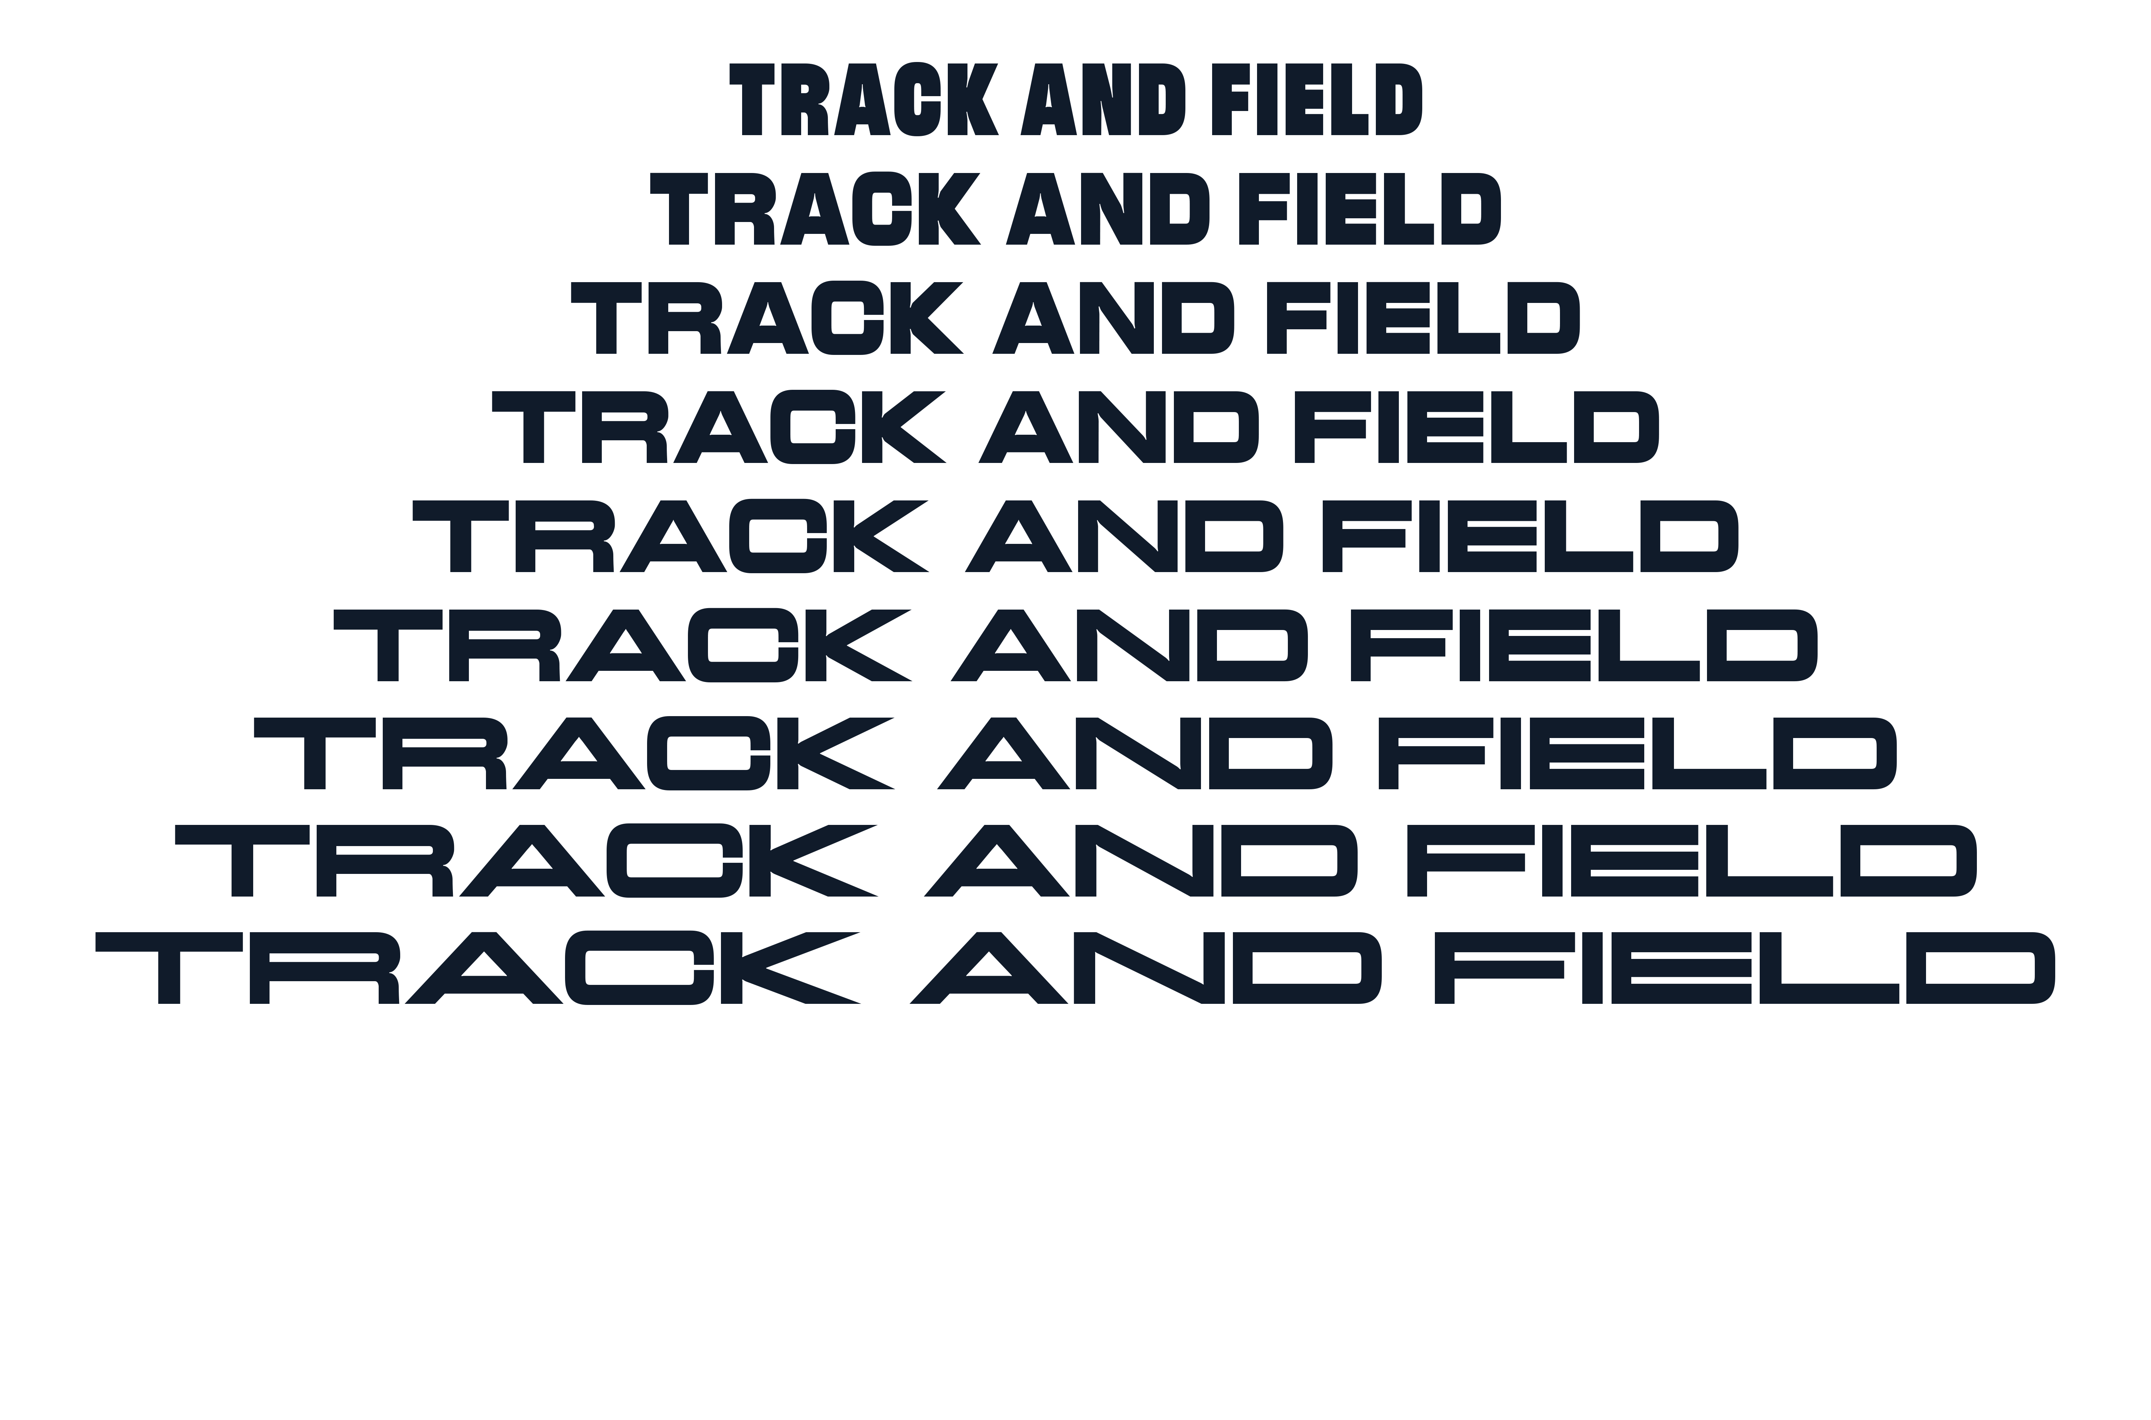
DISPLAY FONT
Headlines
Theme Phrase

Slide 63

DISPLAY FONT
Headlines
Theme Phrase

Slide 64
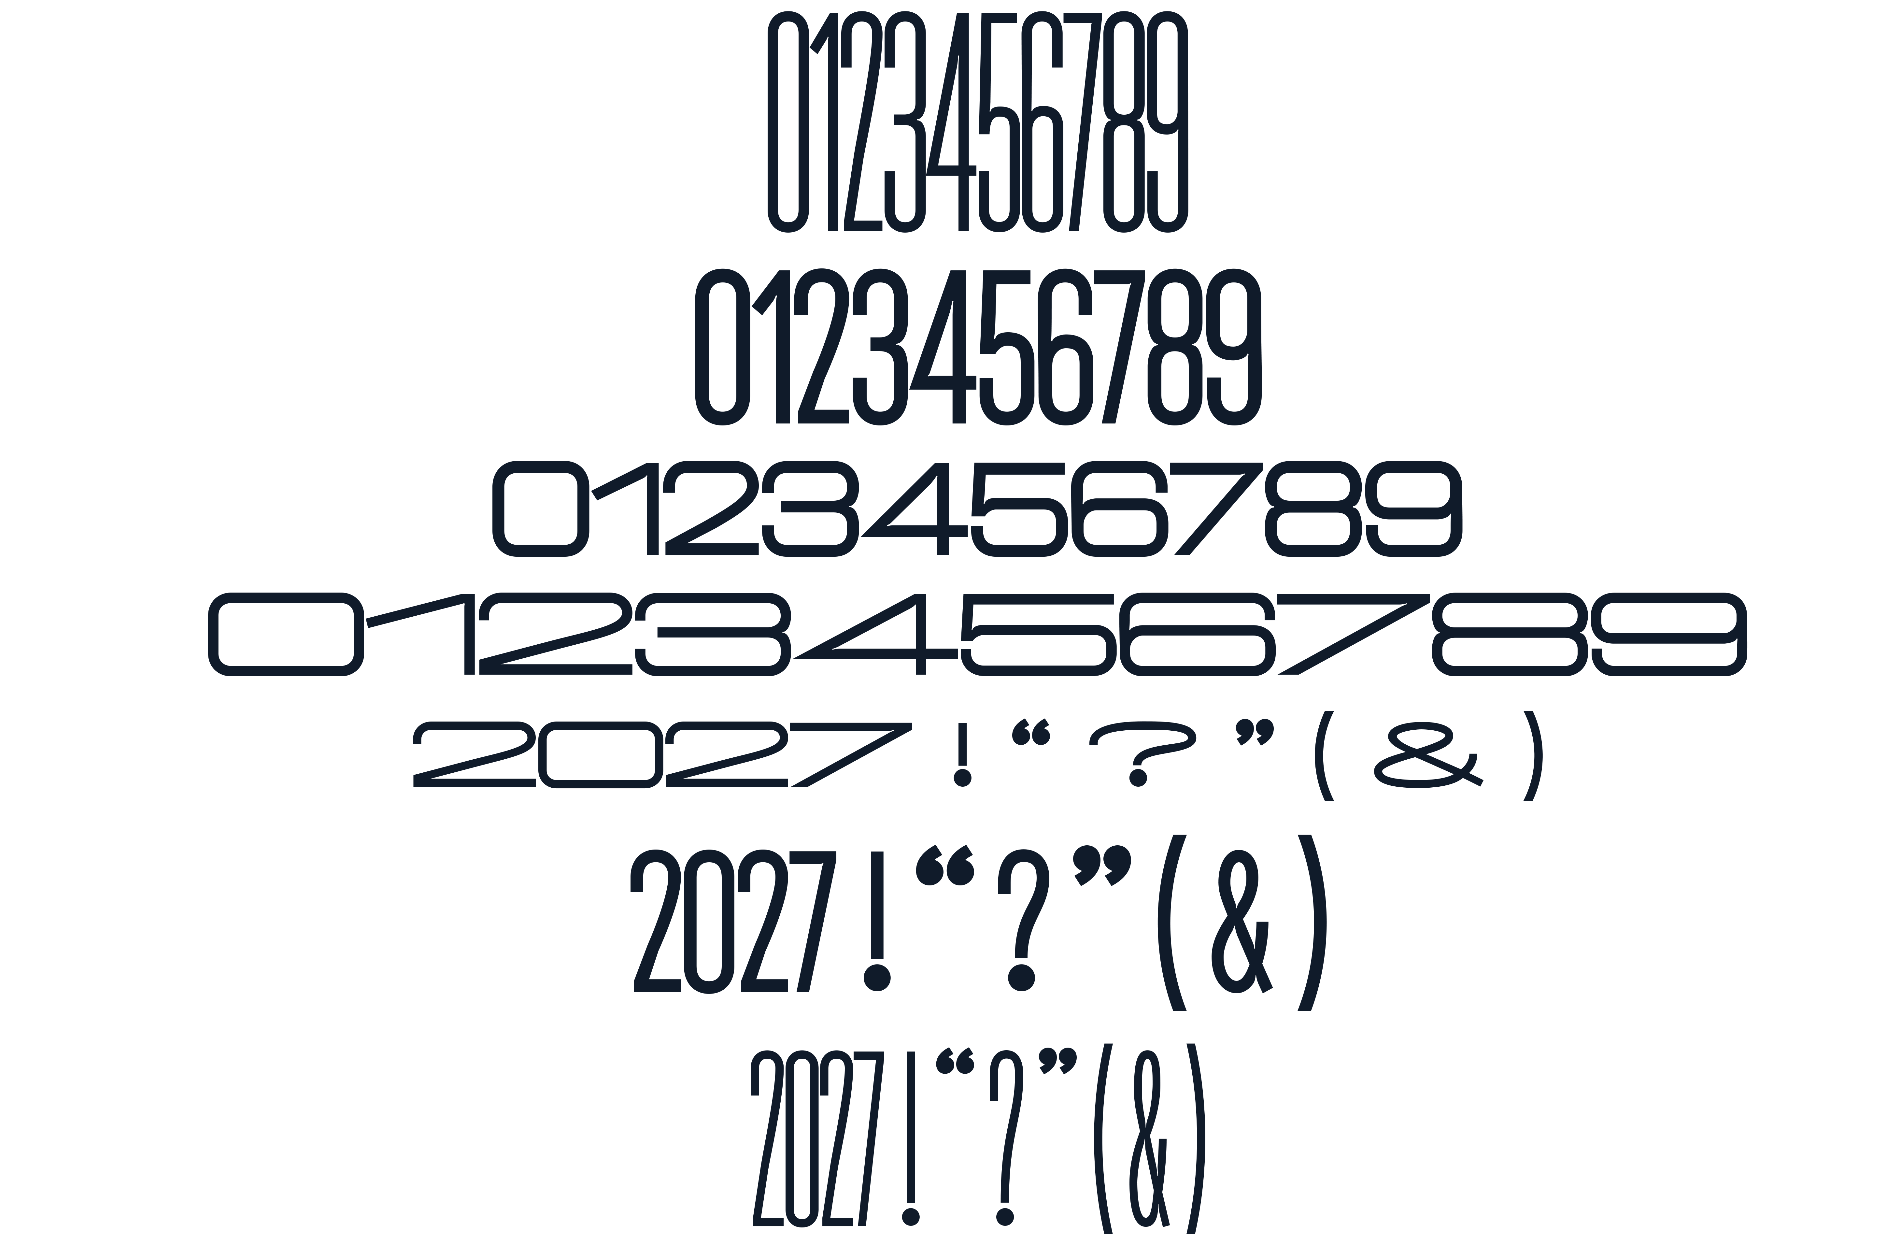
DISPLAY FONT
Headlines
Theme Phrase

Slide 65

DISPLAY FONT
Headlines
Theme Phrase

Slide 66
Walsworth has over 400 fonts to choose from
(but you don’t need them ALL)

Slide 67
By choosing just 3-4 fonts, you will establish a clean and cohesive look.
Too many fonts cause visual noise, distracting the viewer from your core message and making your layout appear cluttered, unprofessional, or confusing.

Slide 68
You will need:
1-2 Headline Fonts
Cover Theme Phrase
Headlines
Some Mods
Senior Ads?
If using a combination of two fonts, be sure they work well together and achieve a balanced look

Slide 69
You will need:
1-2 Headline Fonts
These fonts set the tone and personality for the whole book.
The WORDS of your theme phrase are the “lyrics,”
and the FONT is the “music.”

Slide 70
You will need:
1-2 Body Copy Fonts
Subheads
Captions
Stories
Folio Information
Page Numbers

Slide 71
You will need:
1-2 Body Copy Fonts
Choose body fonts with a few family members to give your designs some visual variety.
For Example: thin for subheads, bold for names in captions and stories, and italics for photo credits.

Slide 72
You will need:
1-2 Body Copy Fonts
These fonts are ALSO introduced on the cover and spine.
Use them for your book name, volume, city and state.

Slide 73
You MIGHT need:
1 Accent Font*
Mods
Pull quotes
Folio
Senior Ads
*But before adding an extra font, see if an italic version of your other fonts will serve this purpose

Slide 74
Now is the time to experiment & play!
Start with your theme phrase
Put every word in its own box
Try a variety of fonts, sizes and treatments
READABILITY IS KEY! You’ll want to read these captions and stories decades from now. If Grandma can’t read it, choose a different font.

